Slide 1
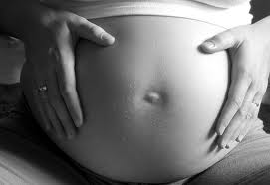
Aggregate At Risk
Hispanic Teenagers and Teenage Pregnancy
By Eve Wittlin-Young , RN

Slide 2
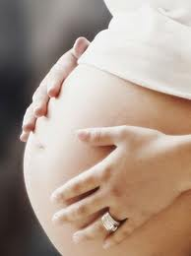
Demographics, Epidemiological and Statistical Data
The United States holds the highest rates of teen pregnancy in the western industrialized world, with Florida rated as the sixth highest in the nation (Family first aid, 2004).
After a consistent and steady decline since the early 1990s, teen pregnancies and birth rates are on the rise with teen pregnancy up 3% and birth rates showing a 5% increase (The National Campaign, 2010).

Slide 3


Demographics, Epidemiological and Statistical Data continued
It is estimated that 750,000 American teenagers become pregnant every year (Maurer & Smith, 2009).
The National Campaign to prevent teen and unplanned pregnancy (2010), states that eight in ten of these pregnancies are unintended and 81 percent are to unmarried teens.

Slide 4
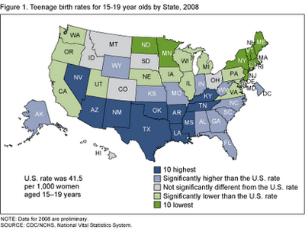
Demographics, Epidemiological and Statistical Data continued
This is a State-specific teenage birth rates map that presents the data for 15-19 year olds birth rates by state. This presents the fact that the rates are highest across the Southern United States (NCHS, 2010).

Slide 5
Demographics, Epidemiological and Statistical Data continued
Minority teens are most vulnerable to first coitus at early age with subsequent childbearing.
In 2003, Hispanic and African American teens had birth rates more than double that for Caucasian teens.
Talashek, Alba, & Patel, 2006

Slide 6
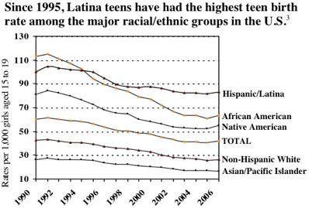
Demographics, Epidemiological and Statistical Data continued
This chart presents the data that Hispanics have consistently had the highest births rates among racial groups in the U.S.
The National Campaign, 2008

Slide 7


Demographics, Epidemiological and Statistical Data continued
Teenage birth rates have historically been higher for Hispanic teenagers than for non-Hispanic white teenagers (NCHS, 2010)
A study by the National Center for Health Statistics showed that, in the United States, Hispanic teenagers (age 15-19) have the highest pregnancy rates at 81.8, while White non-Hispanic teenage girls have the least at 27.2, and with African American non-Hispanic girls in the middle at 64.2 per 1,000 women in 2007 (NCHS, 2010).

Slide 8
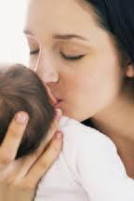
Demographics, Epidemiological and Statistical Data continued
Interestingly, rates for non-Hispanic white and Hispanic teenagers were uniformly higher in the Southeast and lower in the Northeast and California (NCHS, 2010).
In 2007, the birth rate for Hispanic teenagers, 81.8 per 1,000 aged 15–19 years, which was nearly three times the rate for non-Hispanic white teenagers, 27.2 (NCHS, 2010)

Slide 9
Demographics, Epidemiological and Statistical Data
Compared with the national birth rate for Hispanic teenagers, birth rates were significantly lower for Hispanic teenagers in California, New York, New Jersey, and Florida, which together accounted for 38% of Hispanic teenage births in 2007 (NCHS, 2010).
However, state-specific birth rates for Hispanic teenagers exceeded the national Hispanic teenage birth rate in 35 states and the District of Columbia (NCHS,2010).

Slide 10
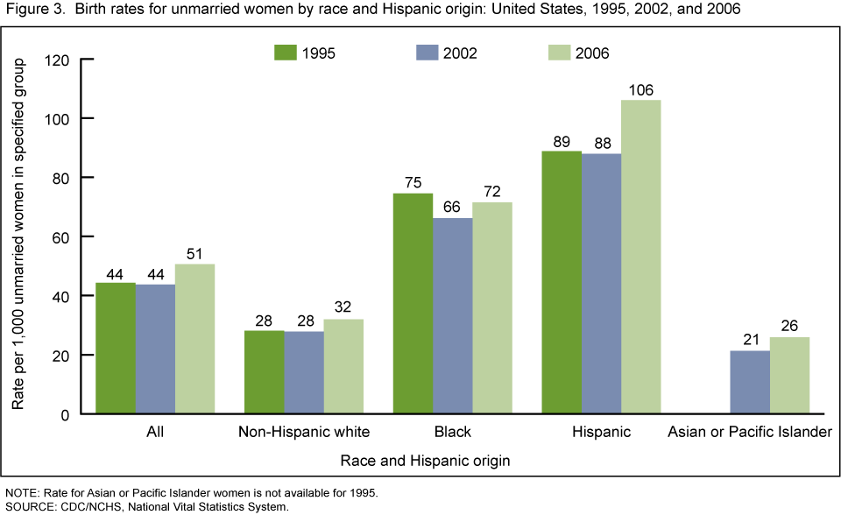
Demographics, Epidemiological and Statistical Data continued
This graph visually depicts the birth rates for unmarried woman by race comparing the years of 1995, 2002 and 2006.
CDC, 2009

Slide 11

Social, Political, Economic and Cultural factors and their impact
With teen pregnancy and birth come many social, political and economic consequences:
Statistics show that only about one third of pregnant teenagers go on to receive their diploma (Swierzewski, 2007).
More than 50% of all teen mothers receive welfare assistance after the birth of their child (Maurer & Smith, 2009)
An estimated $23.6 billion in services was provided in 2004 to families headed by females who were teens when they had their first child (Maurer & Smith, 2009)

Slide 12
Social, Political, Economic and Cultural factors and their impact
Seventy percent of women receiving Temporary Assistance for Needy Families, TANF, say their trusted source of information on preventing pregnancy is a healthcare professional, however, only forty percent say they have actually received information about preventing pregnancy from their provider.
Brown, S., 2010

Slide 13
Social, Political, Economic and Cultural factors and their impact continued
Other consequences of teen pregnancy that studies conclude include children of teen mothers have:
Lower birth weights
Are more likely to perform poorly in school
Are at a greater risk for abuse and neglect (Maurer & Smith, 2009).
Interestingly statistics also show that the sons of teen mothers are thirteen percent more likely to end up in prison and teen daughters are twenty two percent more likely to become teen moms themselves (Family First Aid, 2004).

Slide 14

Social, Political, Economic and Cultural factors and their impact continued
Teen pregnancies cost the United States at least seven billion dollars annually from lost tax revenues, public assistance, child health care, foster care and involvement in the criminal justice system (Swierzewski, 2007).
Clearly, teen pregnancy not only effects the teens and their families but it affects the health and well being of the entire Nation, as well as our communities.

Slide 15
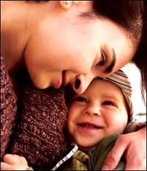
Social, Political, Economic and Cultural factors and their impact continued
Cultural Factors:
Hispanic teenagers who become pregnant are less likely to have an abortion, experts believe the lower abortion rates is related to the large number of Roman Catholics among the nation’s Hispanics (Melby, T., 2006).
Teen pregnancy is not necessarily forbidden in the Hispanic community, many times the Hispanic girl will receive great support from family and friends (Melby, T., 2006).
African Americans chose abortion at twice the rate of Hispanic teens, 49.4 per 1000 versus 28.5 per 1000 (Maurer & Smith, 2009).

Slide 16

Social, Political, Economic and Cultural factors and their impact continued
Sociocultural Factors
Hispanic adolescents with higher acculturation levels are more likely to be sexually active than adolescents with lower acculturaton (Talashek, Alba, & Patel, 2006).
Many girls report that in their social circles early childbearing was common, almost 70% identified an adolescent friend or sibling who was either pregnant or had a child (Maurer & Smith, 2009).

Slide 17

Prevalent Health Problems
Teen mothers and their infants are at greater risk for serious medical complications, infant low birth weight, and poorer outcomes than older women and their infants (Maurer & Smith, 2009).

Slide 18
Prevalent Health Problems continued
A third of pregnant teens receive inadequate prenatal care
Many delay seeking prenatal care or do not receive regular care
Pregnant adolescents are more likely to smoke and about 50% of all pregnant teens drink during their pregnancy
Hispanic teens may not have access to health care services
Language skills, poverty and immigration status are barriers preventing many Hispanics from finding the adequate healthcare needed
Maurer & Smith, 2009
Melby, T., 2006

Slide 19

Prevalent Health Problems continued
Teenagers are at a greater risk for developing pregnancy induced hypertension and toxemia
Teenagers are also at an increased risk for anemia, nutritional deficiencies, poor weight gain and urinary tract infections
Maurer & Smith, 2009

Slide 20
Prevalent Health Problems continued
20% of teens do not use protection during intercourse
Each year, about 9 million adolescents contract an STD
In 2008, a Centers for Disease Control and Prevention study reported that 26% of girls between the ages of 14 and 19 (3.2 million girls) were infected with at least one common type of STD
Maurer & Smith, 2009

Slide 21

Prevalent Health Problems continued
Healthy People 2020 National Objectives Related to Teen Pregnancy
FP HP2020–8 Reduce the pregnancy rate of adolescent females
FP HP2020–9: Increase the proportion of adolescents aged 17 years and under who have never had sexual intercourse.
(USDHHS, 2009)

Slide 22

Prevalent Health Problems continued
FP HP2020–10: Increase the proportion of sexually active adolescents aged 15 to 19 years who use contraception that both effectively prevents pregnancy and provides barrier protection against disease.
FP HP2020–11: Increase the proportion of adolescents who received formal instruction on reproductive health topics before they were 18 years old.
FP HP2020–15: Increase the percentage of women in need of publicly supported contraceptive services and supplies who receive those services and supplies.
AH HP2020–3: Increase the percentage of adolescents who have been tested for HIV.
USDHHS, 2009)

Slide 23

Prevalent Health Problems continued
MICH HP2020–7: Reduce low birth weight (LBW) and very low birth weight (VLBW).
MICH HP2020–10: Increase abstinence from alcohol, cigarettes, and illicit drugs among pregnant women.
MICH HP2020–17: (Developmental) Increase the proportion of mothers who achieve a recommended weight gain during their pregnancies.
MICH HP2020–5: Increase the proportion of pregnant women who receive early and adequate prenatal care.
USDHHS, 2009)

Slide 24

Health Beliefs and Practices
During early adolescence feelings of affiliation and abandonment are prevalent; girls tend to know themselves through relationships with others (Talashek, Alba, & Patel, 2006).
Many teenage girls say that they have little knowledge of even common contraceptive methods such as condoms and the pill, and most have not even heard of the less common methods such as the implant (Brown, S., 2010).
Many teenage girls claim that it doesn’t matter whether birth control is used and state “when it is your time to get pregnant it will happen” (Brown, S., 2010).

Slide 25
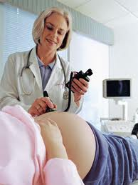
Health Belief and Practices continued
With the increase in sexual activity among teenagers, there is not necessarily an increased knowledge about sexual function or birth control.
Teenagers lack accurate knowledge about birth control methods and the correct use of contraceptives
Cost is an issue for most teenagers to practice effective birth control methods
Maurer & Smith, 2009

Slide 26

Health Beliefs and Practices continued
Fewer than one half (46 %) of all unmarried Hispanic teens said they would be “very upset” if they became pregnant
Some Hispanic women are not viewed as women until they become mothers. Also, the yearning to have children in response to gender roles and responsibilities are a few of the cultural beliefs.
Melby, T., 2006

Slide 27
Prioritized Problems, Needs and Risks for Hispanic Teenagers and Pregnancy
In order to effectively address teen pregnancy among our Hispanic population we must first establish and prioritize the problems, needs and risks for this aggregate.

Slide 28
Prioritized Problems, Needs and Risks for Hispanic Teenagers and Pregnancy continued
Prioritized Problem 1: Deficient Knowledge of Sexual Education
Deficient Knowledge of sexual education among Hispanic teenage girls related to lack of exposure, misbeliefs, and unfamiliarity with information resources as evidenced by the high rates of STDs among teenagers and the high birth rates of Hispanic teenagers.
Address the deficient knowledge of sexual education in order to promote a delay in sexual activity and or increase the use of contraceptives in hopes to decrease risky behaviors that may lead to teen pregnancy and STDs. Address the misbeliefs of the Hispanic teenagers and encourage academic goals and life purpose.

Slide 29
Prioritized Problems, Needs and Risks for Hispanic Teenagers and Pregnancy continued
Prioritized Problem 2: Risk for Impaired Health Maintenance
Risk for Impaired Health Maintenance among Hispanic teenage girls related to altered communication skills, lack of resources, insufficient planning, insufficient finances, and lack of knowledge as evidence by Hispanic teenagers receiving inadequate prenatal care, not having the access to health care services for prenatal care, possible language barriers, poverty and the fact that they are more likely to smoke and about 50% of all pregnant teens drink during their pregnancy.
Outcome: Increase the access of services in order for this aggregate at risk to obtain early prenatal, encourage consistent prenatal care through ease of services and education, offer more bilingual assistance to encourage proper health maintenance. Assess, teach and monitor the teen mom in order to maintain nutritional status and prevent medical complications to ultimately produce a healthy birth and delivery for mom and infant.

Slide 30
Prioritized Problems, Needs and Risks for Hispanic Teenagers and Pregnancy continued
Prioritized Problem 3: Risk for Altered Parenting
Risk for Altered Parenting related to lack of experience, lack of knowledge, and ineffective role model as evidence by the conclusion of studies that suggest the children of teen mothers are at a greater risk for abuse and neglect, as well as the statistics that show the sons of teen mothers are thirteen percent more likely to end up in prison and teen daughters are twenty two percent more likely to become teen moms themselves.
Outcomes: Prevent neglect and abuse among the children of teenage mothers. Hispanic teen mothers will attend parenting classes and utilize other community resources as needed in order to increase knowledge on parenting skills, learn expected growth and development of their child and increase their support system.

Slide 31
Plan of Care: Primary, Secondary and Tertiary Strategies
Primary Prevention
Primary prevention has three focuses:
Delay or stop participation in sexual activity
To provide access to contraceptives
To strengthen future goals
Intervention Strategies
Strengthen the education of Hispanic teenagers through comprehensive sex education that provides accurate information about the risks and consequences of teen sexual activity such as the risk of contracting STDs, pregnancy, possibility of not obtaining their high school diploma, risks of medical complications and living in poverty.
Teach the effectiveness and correct use of contraceptives.
Discuss family planning that addresses the stress and consequences of becoming a teen parent and encourage academic and future goals.
Maurer & Smith, 2009

Slide 32
Plan of Care: Primary, Secondary and Tertiary Strategies
Secondary Prevention
Secondary prevention should focus on reducing the health risks for both the pregnant teenager and her infant.
Intervention Strategies
Promote early detection with the use of free pregnancy screenings, as well as providing education to teenagers of the early signs of pregnancy such as fatigue, nausea, vomiting, and missed menstrual periods
Offer education on pregnancy resolution services such as abortion and adoption.
Investigate all of the financial options and prenatal programs for the pregnant teen in order to obtain early and regular prenatal care.
Maurer & Smith, 2009

Slide 33
Plan of Care: Primary, Secondary and Tertiary Strategies
Tertiary Prevention
Tertiary prevention should focus on how to improve the chances of self- sufficiency while ensuring a healthy and supportive environment to the child.
Intervention Strategies
Discuss and investigate contraceptive methods to prevent future unintended pregnancies from occurring
Assess parenting skills and offer parenting classes, individual counseling, and peer support groups.
Maurer & Smith, 2009

Slide 34
References:
Brown, S. (2010). Preventing Teen Unplanned & Pregnancy. Policy & Practice (19426828), 68(2), 11-14. Retrieved from EBSCOhost January 20,2011.
Centers for Disease Control and Prevention. (2009)
Changing Patterns of Nonmarital Childbearing in the
United States. Retrieved January 16, 2011, from
http://www.cdc.gov/nchs/data/databriefs/db18.htm
Family First Aid. (2004). Teen Pregnancy Statistics, Facts and Prevention.
Retrieved January 19,2011, from http://www.familyfirstaid.org/teen- pregnancy.html
Maurer, F., & Smith, C. (2009). Community/ Public Health Nursing Practice: Health For Families and Populations (4th ed.). St Louis, MO: Elsevier Saunders.
Melby, T. (2006). Hispanics become focus of teen pregnancy prevention efforts. Contemporary Sexuality, 40(4), 1-6. Retrieved from EBSCOhost
National Center for Health Statistics. (2010) State Disparities in Teenage Birth Rates in the United States. Retrieved January 16, 2011, from http://www.cdc.gov/nchs/data/databriefs/db46.pdf

Slide 35
References:
Swierzewski, S. (2007). Teen Pregnancy. Retrieved January 22, 2011, from
http://www.womenshealthchannel.com/teenpregnancy/index.shtml
Talashek, M. L., Alba, M. L., & Patel, A. (2006). Untangling the Health Disparities of Teen Pregnancy. Journal for Specialists in Pediatric Nursing, 11(1), 14-27. Retrieved January 20, 2011, from Academic Search Premier.
The National Campaign. (2008). A Look at Latinos: An Overview of Latina Teen
Pregnancy and Birth Rate. Retrieved January 20, 2011, from http://www.thenationalcampaign.org/espanol/PDF/latino_overview.pdf
The National Campaign. (2010). The National Campaign to Prevent Teen and Unplanned Pregnancy. Retrieved January 19, 2011, from http://www.thenationalcampaign.org/national/
United States Department of Health and Human Services. (2009). Proposed Healthy People 2020 Objectives. Retrieved January 22, 2011, from http://www.healthypeople.gov/hp2020/Objectives/TopicAreas.aspx

